Slide 1
Findings:
2014 Education Lab Survey
Strategic Research November 2014

Slide 2
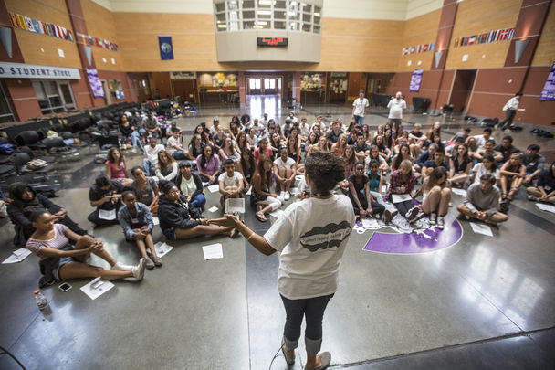
Education Lab
Education Lab is a yearlong project to spark meaningful conversations about education solutions in the Pacific Northwest.

Slide 3
Objectives and Methodology
Background and Objectives
This study was developed to assess the brand awareness of Education Lab and reader response to the series. Education Lab began publishing stories in October of 2013.
The specific objectives of the study were to:
  Review how respondents learned about the coverage (e.g., in-paper, online, social media, etc.)
  Assess brand awareness of Education Lab, online and in print
  Assess whether readers feel this is a “different” form of reporting
  Assess level of response to this content (e.g., thought about it, commented, forwarded to a friend, etc.)

Slide 4
Objectives and Methodology, cont.
  The survey was hosted via Qualtrics and sent via email to 2,574 emails
  A total of 780 people completed most of the survey
  The survey was in the field between August 19th and September 9th 2014
  Survey participants were entered into a drawing for a $100 gift card

Slide 5
Respondent Sources
  Connect Panel: 1,500+ Seattle Times subscribers who have opted-in to become part of our research panel, includes print and online readers
  Newspaper in Education (NIE) Educators: Respondents on a known list (list of about 400)
  Invitation: Respondents who received an invitation to take the survey from another respondent (snowball sample)
  Intercept: Respondents who found the link to the survey during their visit to seattletimes.com and the Education Lab series
  Newsletter: Respondents who learned about the survey through the Education Lab newsletter (list of 684)
 | Connect Panel | NIE Educator | Invitation | Intercept | Newsletter
Count | 544 | 106 | 20 | 26 | 84
Percent of Total Respondents | 70% | 14% | 3% | 3% | 11%

Slide 6
How Respondents Describe Themselves
N=608
Q: Please indicate whether you are a: Teacher, School Administrator, Student, Parent, Grandparent, Concerned Citizen, Other
Source: 2014 Education Lab Survey, The Seattle Times, September 2014

Slide 7
Summary of Findings

Slide 8
Summary of Findings
Respondent awareness of Education Lab series is high, especially among education professionals and parents
Readers of the series are highly engaged with the education topic
About half of respondents indicated that the Education Lab stories seem different from other types of journalism
Education Lab stories changed perceptions about story subjects for more than half of respondents

Slide 9
Detailed Findings

Slide 10
Awareness of Education Lab
Q: Have you seen or read the series of Seattle Times stories about education and schools called Education Lab? Please select one response
Source: 2014 Education Lab Survey, The Seattle Times, September 2014

Slide 11
Source of Awareness (count)
Q: What are the ways you found out about these stories? And what would be your preferred way? [Select all that apply]
Source: 2014 Education Lab Survey, The Seattle Times, September 2014

Slide 12
News Topics (% following very or fairly closely)
Q: Please indicate how closely you have followed these news stories covered by news organizations in the past year.
Source: 2014 Education Lab Survey, The Seattle Times, September 2014

Slide 13
More respondents from education-related lists report following education related news “very closely”
Q: Please indicate how closely you have followed these news stories covered by news organizations in the past year: education
Source: 2014 Education Lab Survey, The Seattle Times, September 2014

Slide 14
Actions
Education-related respondents are more likely to act: Respondents from education-related sources are more likely to take actions such as sharing Education Lab articles on social media or trying to get involved with working towards solutions
Education Lab may be a gateway to more readership: 80% of respondents involved in education professions indicated that after reading the Education Lab stories they are likely to read more stories by The Seattle Times
Frequent seattletimes.com readers are more likely to take digital actions such as sharing stories
Respondents were less likely to join a live chat: Few respondents of any kind reported being likely to engage in a live chat or commenting about a story. Text chats were, however, well attended.

Slide 15
Actions – Reading and Considering

Slide 16
Actions – Sharing Stories

Slide 17
Actions – Joining Discussion

Slide 18
Count of Chat Participants
While survey respondents expressed they were less likely to join a live chat, text-based live chats were well-attended online, drawing anywhere from 383 to 3,738 attendees, with an average engagement time of 29 minutes
Chat | Number of Participants
October | 1,197
November | 1,373
December | 857
February | 383
August | 3,738

Slide 19
Education Lab Stories

Slide 20
Are Ed Lab Stories Different? (top stories)
Q: Please indicate how much you agree or disagree with the following statements about this story: The article seemed different from typical news stories [1-5 scale]
Source: 2014 Education Lab Survey, The Seattle Times, September 2014

Slide 21
“Now that I've read this article, I think there are ways to effectively address this problem” (all stories)
Source: 2014 Education Lab Survey, The Seattle Times, September 2014, N=242

Slide 22
“The story changed the way I think about this topic” (all stories)
Source: 2014 Education Lab Survey, The Seattle Times, September 2014

Slide 23
“I appreciated the focus on a solution that seemed to be working” (all stories)
Source: 2014 Education Lab Survey, The Seattle Times, September 2014

Slide 24
Less Lecturing, more doing: New Approach for AP Classes
Q: Please indicate how much you agree or disagree with the following statements about this story
Source: 2014 Education Lab Survey, The Seattle Times, September 2014

Slide 25
Solutions Journalism

Slide 26
Solutions Journalism’s mission is to present issues, tell stories, identify potential solutions and/or motivate citizen involvement. Based on what you had read in The Seattle Times Education Lab Series, how do you think these stories are or are not accomplishing the Solutions Journalism mission?
  Education Lab articles are meeting their mission: The strongest theme in the open-ended responses is that the articles are meeting their mission (151 of 400 comments).
  Education Lab articles do not provide specific actions for readers to take: Another, less common, theme is respondents indicating that the articles achieve portions of the mission but may lack clear directives to motivate citizen involvement
  Opinions about solutions journalism are mixed: Some respondents reacted favorably to the positive, solutions-oriented presentation of the information while some respondents reacted negatively to the approach describing it as “biased.”
Source: 2014 Education Lab Survey, The Seattle Times, September 2014

Slide 27
Meeting the Mission of Solution’s Journalism (151 comments)
Appreciate positive solutions in real-world local schools. – Citizen
As a teacher they offer me inspiration and information to do everything I can to help.-Education professional and parent
Education Lab is shining light on solutions for problems that many schools struggle with. I find it refreshing and stimulating intellectually to read the stories written for Education Lab. I look forward to each new story. I talk with colleagues about the stories published in the Times.- Education professional and parent
I believe it does motivate citizen involvement - by allowing for commenting it fosters a community feeling.- Education professional
I can use them in my classroom to discuss issues relevant to my students.- Education professional
I think the solutions journalism's mission is being achieved. This is an incredible series and I hope that you continue it indefinitely. It has helped in more ways than you an imagine. I hear colleagues talking about the articles. I see parents willing to step up and help as well as ask crucial questions of their kids' schools and administrators. Please continue this series until we get it right. –Education professional and parent

Slide 28
Respondents Unsure if Stories are Motivating
(22 comments)
I believe that these articles are on the path to fulfilling the mission. Would like to see a more direct call to action if part of the mission is to motivate citizen involvement. – Parent
I think the stories are educating the reader about problems and solutions in education. I'm not sure whether they motivate citizen involvement unless you mean by how a person votes.- Education professional
I think they are not accomplishing encouraging readers to get involved because they don't explain how. – Parent
I think they are doing a great job at highlighting areas of strength and success. However, I am not sure how well they are at linking others to resources to achieve similar successes. – Education professional
I don't remember a lot of content for motivating the average citizen involvement, for people who aren't families of the students. - Citizen

Slide 29
Bias (16 comments)
The underwriting of daily newspaper journalism by Gates, either directly or indirectly, has compromised, perhaps fatally, the Seattle Times' credibility as a news source. – Newsletter recipient
Generally, I find the Seattle Times coverage of educational issues to be incredibly slanted and biased, typically seeking any opportunity to bash teachers. – Education professional
Given the Seattle Times editorial bias in favor of charter schools, I am skeptical of any education story the Times promotes. – Citizen
I think the stories are very unbiased.- Educator and parent
Inherently unreliable, based on gates foundation funding. Clear anti-educator slant that mimics the editorial board. – Newsletter recipient
The stories need to have less bias towards corporate reform efforts funded by the Gates Foundation--which is far too obvious in the majority of stories. Journalism should remain non-biased.- Education professional
The stories seemed slanted towards Education reformers viewpoints. Since Gates Foundation paid for them I never trusted them, to be honest. - Parent

Slide 30
Reading Behavior

Slide 31
Sunday Printed
Q: How often do you read the Sunday Seattle Times printed newspaper?
Source: 2014 Education Lab Survey, The Seattle Times, September 2014

Slide 32
Weekday Printed
Q: How often do you read the weekday, Monday through Saturday, Seattle Times printed newspaper?
Source: 2014 Education Lab Survey, The Seattle Times, September 2014

Slide 33
Seattletimes.com
Q: How often do you typically access The Seattle Times website, seattletimes.com?
Source: 2014 Education Lab Survey, The Seattle Times, September 2014

Slide 34
Questions?
For questions or clarifications please contact Janet Farness or April Armstrong at The Seattle Times.
Janet Farness
206-464-8782
jfarness@seattletimes.com
April Armstrong
206-464-3760
aarmstrong@seattletimes.com

Slide 35
Appendix

Slide 36
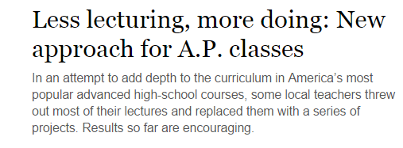
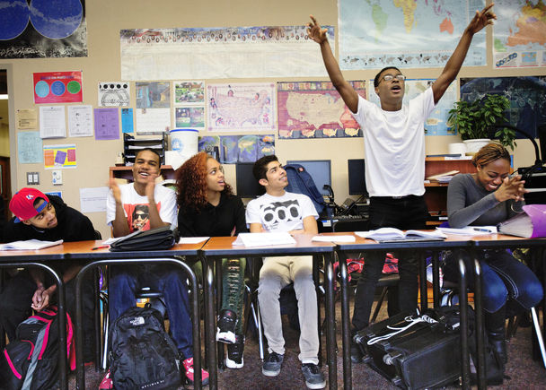

Slide 37
Less Lecturing, more doing: New Approach for AP Classes
Q: Please indicate how much you agree or disagree with the following statements about this story
Source: 2014 Education Lab Survey, The Seattle Times, September 2014

Slide 38
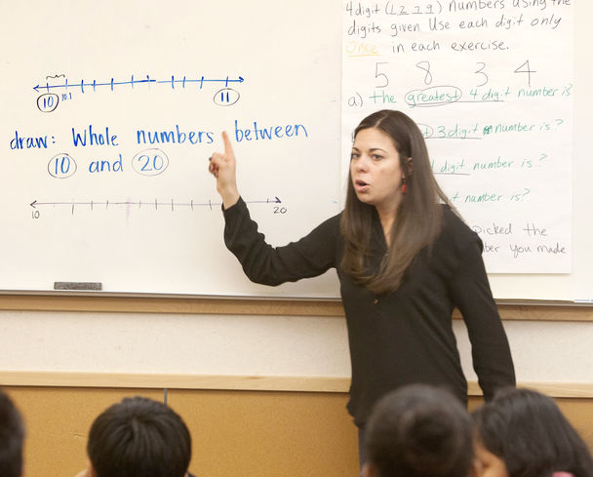
Teachers jump-start turnaround at White Center Heights Elementary
For years, students at White Center Heights Elementary logged some of the lowest test scores in King County. Then teachers tried something new, and the numbers soared by double-digits after just one year. So what happened, and could it be replicated elsewhere?

Slide 39
Teachers jump-start turnaround at White Center Heights Elementary
Q: Please indicate how much you agree or disagree with the following statements about this story
Source: 2014 Education Lab Survey, The Seattle Times, September 2014

Slide 40
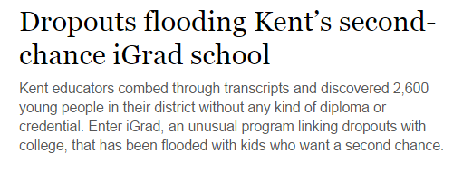
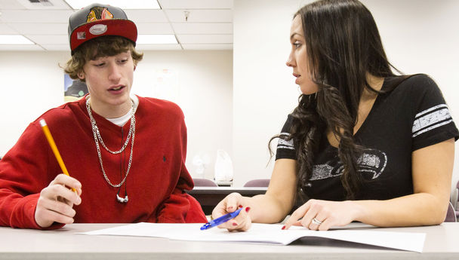

Slide 41
Dropouts flooding Kent's second-chance iGrad school
Q: Please indicate how much you agree or disagree with the following statements about this story
Source: 2014 Education Lab Survey, The Seattle Times, September 2014

Slide 42
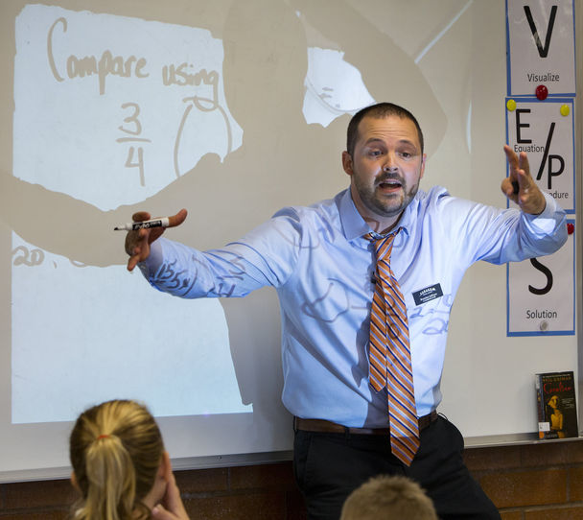
High poverty, high test scores: Auburn school is a shouting success
Auburn’s Gildo Rey Elementary shows one way to achieve high test scores with teaching that’s direct, consistent – and fast.

Slide 43
High poverty, high test scores: Auburn school is a shouting success
Q: Please indicate how much you agree or disagree with the following statements about this story
Source: 2014 Education Lab Survey, The Seattle Times, September 2014

Slide 44
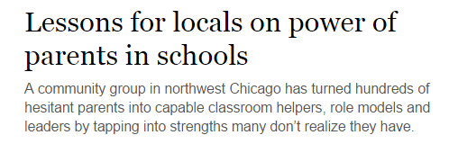
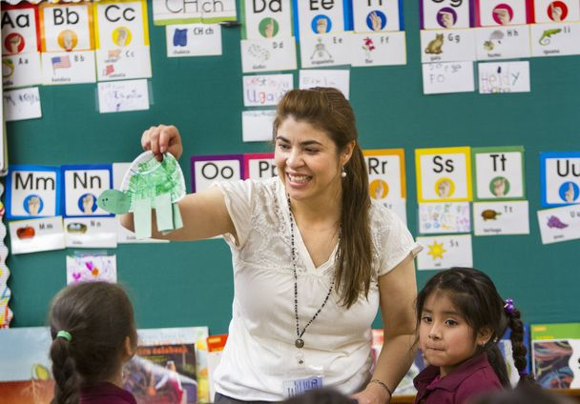

Slide 45
Lessons for locals on power of parents in schools
Q: Please indicate how much you agree or disagree with the following statements about this story
Source: 2014 Education Lab Survey, The Seattle Times, September 2014

Slide 46
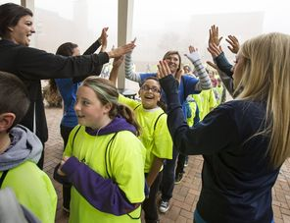
Mentors have message for kids:
Go to college
Western Washington University college students are working as mentors, tutors an role models for thousands of k-12 students in and around Bellingham. The goal: convince them that college should be part of their educational trajectory.

Slide 47
Mentors have message for kids: Go to college
Q: Please indicate how much you agree or disagree with the following statements about this story
Source: 2014 Education Lab Survey, The Seattle Times, September 2014

Slide 48
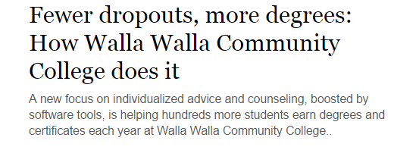


Slide 49
Fewer dropouts, more degrees: How Walla Walla Community College does it
Q: Please indicate how much you agree or disagree with the following statements about this story
Source: 2014 Education Lab Survey, The Seattle Times, September 2014

Slide 50
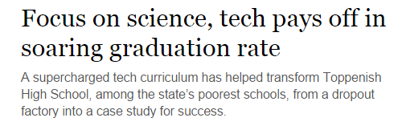


Slide 51
Focus on science, tech pays off in soaring graduation rate
Q: Please indicate how much you agree or disagree with the following statements about this story
Source: 2014 Education Lab Survey, The Seattle Times, September 2014

Slide 52
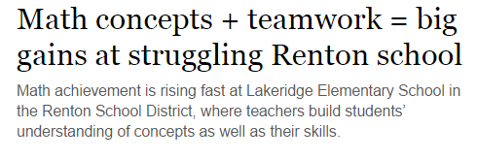
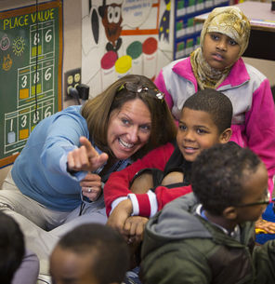

Slide 53
Math concepts + teamwork = Big gains at struggling Renton school
Q: Please indicate how much you agree or disagree with the following statements about this story
Source: 2014 Education Lab Survey, The Seattle Times, September 2014

Slide 54
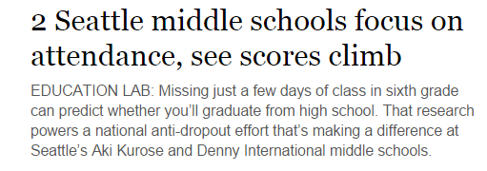
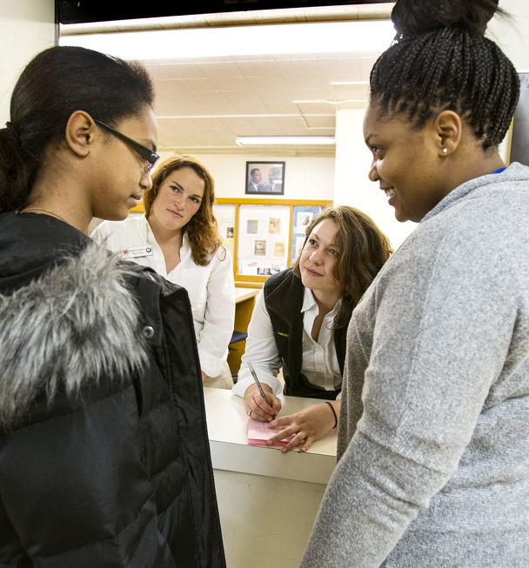

Slide 55
2 Seattle middle schools focus on attendance, see scores climb
Q: Please indicate how much you agree or disagree with the following statements about this story
Source: 2014 Education Lab Survey, The Seattle Times, September 2014

Slide 56
Readers per Ed Lab Story
Story | Count of Readers Surveyed | Count of Online Readers (web metrics)
Teachers jump-start turnaround at White Center Heights Elementary For years, students at White Center Heights Elementary logged some of the lowest test scores in King County. Then teachers tried something new, and the numbers soared by double-digits after | 340
High poverty, high test scores: Auburn school is a shouting success | 283
Less lecturing, more doing: New approach for A.P. classes | 268
Focus on science, tech pays off in soaring graduation rate | 249
Dropouts flooding Kent's second-chance iGrad school Kent educators combed through transcripts and discovered 2,600 young people in their district without any kind of diploma or credential. Enter iGrad, an unusual program linking dropouts with colleg | 195
Mentors have message for kids: Go to college Western Washington University | 192
Fewer dropouts, more degrees: How Walla Walla Community College does it | 175
Math concepts + teamwork = big gains at struggling Renton school Math achievement is rising fast at Lakeridge Elementary School in the Renton School District, where teachers build student’s understanding of concepts as well as their skills. | 168
2 Seattle middle schools focus on attendance, see scores climb Missing just a few days of class in sixth grade can predict whether you’ll graduate from high school. That research powers a national anti-dropout effort that’s making a difference | 168
Lessons for local on power of parents in schools | 150
Q: Please check if you have read or looked at the following Education Lab story in The Seattle Times...
Source: 2014 Education Lab Survey, The Seattle Times, September 2014

Slide 57
Readers of Multiple Stories
Count of Stories | Percent reading
1 | 26%
2 | 18%
3 | 15%
4 | 11%
5 | 7%
6 | 6%
7 | 5%
8 | 5%
9 | 2%
10 | 3%
Compiled from multiple questions
Source: 2014 Education Lab Survey, The Seattle Times, September 2014

Slide 58
Online Reading Frequency and Digital Action
Action | Online Frequent Readers of seattletimes.com (n=390) | Online Infrequent Readers of seattletimes.com (n=207)
Share or ‘like’ a story on social media | 24% | 8%
Comment on a story at seattletimes.com | 16% | 7%
Sign up for email newsletter | 23% | 9%
Email a story to friends or family | 33% | 22%
Q: Compiled from various questions
Source: 2014 Education Lab Survey, The Seattle Times, September 2014, n=804

Slide 59
Demographic Profile (connect panel only, N=~540)
Gender | % | Household Size | %
Male | 54 | One | 18
Female | 46 | Two | 57
Age | % | Three | 11
18-24 | 0 | Four | 10
25-34 | 3 | Five or more | 3
35-44 | 9 | Children in Household | %
45-54 | 15 | Yes | 16
55-64 | 32 | No | 84
65+ | 41 | Home Type | %
HH Income | % | Single family home | 82
Under $35,000 | 3 | Apartment | 6
$35,0000-$49,999 | 6 | Other | 12
$50,000-$74,999 | 15 | Home Ownership | %
$75,0000-$99,999 | 16 | Own | 88
$100,000-$149,999 | 20 | Rent | 11
$150,000+ | 13 | Other | 2
DK/Refused | 27

Slide 60
Race, Connect panel (N=~540)
Race | %
White | 86
Asian/PI | 4
Declined | 4
Multiracial | 2
Hispanic | <1
Other | 3

Slide 61
Demographic Profile (N=~185) Non-connect Respondents
Gender | % | Race | %
Male | 39 | White | 85
Female | 61 | Asian | 3
Age | % | Black, African American | 6
18-24 | 3 | Pacific Islander | <1
25-34 | 11 | Other | 5
35-44 | 16
45-54 | 28
55-64 | 30
65+ | 12
HH Income | %
Under $35,000 | 6
$35,0000-$49,999 | 7
$50,000-$74,999 | 20
$75,0000-$99,999 | 17
$100,000-$149,999 | 19
$150,000+ | 8
DK/Refused | 23

Slide 62
Respondent Self Classification
Count of Stories | Percent reading
Teacher | 18%
School administrator | 2%
Student | 1%
Parent of high school or grade school student | 10%
Parent of post-high school child | 20%
Grandparent of school age children | 16%
Concerned citizen | 33%
Q: To help us better categorize responses, please indicate whether you are a:
Source: 2014 Education Lab Survey, The Seattle Times, September 2014, n=804

Slide 63
Political Alignment
Q: Generally speaking, do you think of yourself as…
Source: 2014 Education Lab Survey, The Seattle Times, September 2014

